Slide 1
KOUROSH MESHGI
Occlusion Aware Particle Filter Tracker to Handle Complex and Persistent Occlusions using
Multiple Feature Fusion
PROGRESS REPORT TOPIC
To: Ishii Lab Members,
Dr. Shin-ichi Maeda, Dr. Shigeuki Oba,
And Prof. Shin Ishii
9 MAY 2014

Slide 2
TRACKING APPLICATIONS
Surveillance
Public
Entertainment
MAIN APPLICATIONS
Robotics
Video Indexing
Action Recog.

Slide 3
TRACKING CHALLENGES
Abrupt Motion
Illumination
Occlusion
MAIN CHALLENGES
Deformation
Clutter
Varying Scale

Slide 4
BAYESIAN TRACKING
X₁
X₂
…
X_{t}
States: Target Location and Scale
Goal: Define p(X_{t}|Y₁,…,Y_{t}) given p(X₁)
Y₁
…
Y_{t}
Y₂
Observations: Sensory Information

Slide 5
INTRODUCTION
• • • • • • • • • • • • • • • • • • • • • • • •
PARTICLE FILTER TR.

Slide 6
INPUT IMAGE
Frame: t
RGB Domain

Slide 7
INPUT DEPTH MAP
Frame: t
Depth Domain

Slide 8
SENSORY INFORMATION
Frame: t
Sensory Information

Slide 9
STATE REPRESENTATION & OBSERVATION MODEL
Frame: t
w
(x,y)
State
h
Observation

Slide 10
FEATURES
Color
Texture
Feature Set
Shape
Edge

Slide 11
TEMPLATE
Frame: 1
Template
f₁
…
f_{j}
…
f_{M}

Slide 12
PARTICLES INITIALIZATION
Frame: 1
Particles
Initialized Overlapped

Slide 13
MOTION MODEL
Frame: t
→ t + 1
Motion Model

Slide 14
FEATURE EXTRACTION
Frame: t + 1
Feature Vectors
f₁
f₂
…
f_{M}
X_{1,t+1}
X_{2,t+1}
…
X_{N,t+1}

Slide 15
FEATURE FUSION
Frame: t
!
Each Feature
Independence Assumption
Probability of Observation

Slide 16
PROB. CALCULATION
Frame: t + 1
Particles
Brighter = More Probable

Slide 17
TARGET ESTIMATION
Frame: t + 1
Feature Vectors

Slide 18
MODEL UPDATE
Frame: t + 1
New Model
Model Update

Slide 19
RESAMPLING
Frame: t + 1
Proportional to Probability

Slide 20
CHALLENGES
• • • • • • • • • • • • • • • • • • • • • • • •
PARTICLE FILTER TR.

Slide 21
PFT ISSUES

Appearance Changes
Model Drift
Deficient Feature Space
Uninformed Search
Optimized Feature Selection
Approximation of Target




Slide 22
APPEARANCE CHANGES
Same Color Objects
Background Clutter
Illumination Change
Shadows, Shades
Use Depth!

Slide 23
MODEL DRIFT PROBLEM
Templates Corrupted!
Handle Occlusion!
(No Model Update During Them)

Slide 24
DEFICIENT FEATURE SPACE
* Local Optima of Feature Space
* Feature Noise
* Feature Failures
Regularization
Non-zero Values
Normalization

Slide 25
PERSISTENT OCCLUSION
Particles Converge to Local Optima / Remains The Same Region
Advanced Motion Models
(not always feasible)
Restart Tracking
(slow occlusion recovery)
Expand Search Area!

Slide 26
DYNAMICS…
* The Search is not Directed
* Neither of the Channels have Useful Information
* Particles Should Scatter Away from Last Known Position
Occlusion!

Slide 27
Update model for target → Type of Occlusion is Important → Keep memory vs. Keep focus on the target
OCCLUSION
GENERATIVE MODELS
DISCRIMINATIVE MODELS
do not address occlusion explicitly
☺ maintain a large set of hypotheses
☹ computationally expensive
direct occlusion detection
☺ robust against partial & temp occ.
☹ persistent occ. hinder tracking
Combine Them!
Dynamic Occlusion: Pixels of other object close to camera
Scene Occlusion: Still objects are closer to camera than the target object
Apparent Occlusion: Due to shape change, silhouette motion, shadows, self-occ

Slide 28
OCCLUSION TYPES
PTO partial occlusion
SAO self- or articulation occlusion
TFO temporal full occlusion - shorter than 3 frames
PFO persistent full occlusion
CPO complex partial occlusion - including “split and merge” and permanent changes in a key attribute of a part of target
CFO complex full occlusion

Slide 29
LITERATURE REVIW
[Zhao & Nevatia, 04] Occlusion Indicator: Ratio of FG/BKG
[Wu & Nevatia, 07] Handle Occlusion using Appearance Model
[de Villiers et al., 12] Switch Tracker in the case of Occlusion
[Song & Xiao, 13] Occlusion Indicator: New Peak in HOD or Reduction of the Size of Main Peak
Many other papers handle occlusions as the by-product of their novel trackers
Notes:
Custom animation effects: object spins on end
(Advanced)
To reproduce the background effects on this slide, do the following:
On the Home tab, in the Slides group, click Layout, and then click Blank.
Right-click the slide background area, and then click Format Background. In the Format Background dialog box, click Fill in the left pane, and then select Solid fill in the Fill pane. Click the button next to Color, and then under Theme Colors click White, Background 1 (first row, first option from the left).
To reproduce the rectangle on this slide, do the following:
On the Home tab, in the Drawing group, click Shapes, and then under Rectangles click Rounded Rectangle (second option from the left). On the slide, drag to draw a rounded rectangle.
Select the rectangle. Drag the yellow diamond adjustment handle to the left to decrease the amount of rounding on the corners.
With the rounded rectangle still selected, under Drawing Tools, on the Format tab, in the Size group, do the following:
In the Shape Height box, enter 3.5”.
In the Shape Width box, enter 0.25”.
Under Drawing Tools, on the Format tab, in the bottom right corner of the Shape Styles group, click the Format Shape dialog box launcher. In the Format Shape dialog box, click Fill in the left pane. In the Fill pane, select Solid fill, click the button next to Color, and then under Theme Colors click White, Background 1, Darker 15% (third row, first option from the left).
Also in the Format Shape dialog box, click Line Color in the left pane. In the Line Color pane, select No line.
Also in the Format Shape dialog box, click Shadow in the left pane. In the Shadow pane, click the button next to Presets, under Outer select Offset Bottom (first row, second option from the left), and then do the following:
In the Transparency box, enter 0%.
In the Size box, enter 100%.
In the Blur box, enter 8.5 pt.
In the Angle box, enter 90°.
In the Distance box, enter 1 pt.
Also in the Format Shape dialog box, click 3-D Format in the left pane. In the 3-D Format pane, do the following:
Under Bevel, click the button next to Top, and then under Bevel click Circle (first row, first option from the left). Next to Top, in the Width box, enter 5 pt, and in the Height box, enter 5 pt.
Under Surface, click the button next to Material, and then under Standard click Matte (first row, first option from the left). Click the button next to Lighting, and then under Neutral click Soft (first row, third option from the left).
On the slide, select the rounded rectangle. On the Home tab, in the Clipboard group, click the arrow under Paste, and then click Duplicate.
Select the duplicate rectangle. On the Home tab, in the Drawing group, do the following:
Click the arrow next to Shape Fill, and then click No Fill.
Click the arrow next to Shape Outline, and then click No Outline.
Drag the second rectangle above the first rectangle until the lower edge overlays the top edge of the first rectangle. (Note: When the spinning animation effect is created later for these rectangles, the spin will center where the edges of the rectangles meet.)
Press and hold CTRL, and then select both rectangles. On the Home tab, in the Drawing group, click Arrange, and do the following:
Point to Align, and then click Align Selected Objects.
Point to Align, and then click Align Center.
Click Group.
On the slide, drag the group until it is centered horizontally on the left edge of the slide (straddling the edge).
On the Home tab, in the Drawing group, click Arrange, point to Align, and then do the following:
Click Align to Slide.
Click Align Middle.
To reproduce the dashed arc on this slide, do the following:
On the Home tab, in the Drawing group, click Shapes, and then under Basic Shapes click Arc (third row, 12th option from the left). On the slide, drag to draw an arc.
Select the arc. Under Drawing Tools, on the Format tab, in the Size group, do the following:
In the Shape Height box, enter 7.5”.
In the Shape Width box, enter 7.5”.
With the arc still selected, on the Home tab, in the Drawing group, click the arrow next to Shape Outline, and then do the following:
Under Theme Colors, click White, Background 1, Darker 15% (third row, first option from the left).
Point to Dashes, and then click Dash (fourth option from the top).
On the slide, drag the yellow diamond adjustment handle on the right side of the arc to the bottom of the arc to create a half circle.
Drag the arc until the yellow diamond adjustment handles are on the left edge of the slide.
With the arc still selected, on the Home tab, in the Drawing group, click Arrange, point to Align, and then do the following:
Click Align to Slide.
Click Align Middle.
To reproduce the half circle on this slide, do the following:
On the slide, select the arc. On the Home tab, in the Clipboard group, click the arrow under Paste, and then click Duplicate.
Select the duplicate arc. Under Drawing Tools, on the Format tab, in the Size group, do the following:
In the Shape Height box, enter 3.33”.
In the Shape Width box, enter 3.33”.
With the second arc still selected, under Drawing Tools, on the Format tab, in the Shape Styles group, click the arrow next to Shape Fill, and then under Theme Colors click White, Background 1, Darker 5% (second row, first option from the left).
Under Drawing Tools, on the Format tab, in the Shape Styles group, click the arrow next to Shape Outline, and then click No Outline.
Under Drawing Tools, on the Format tab, in the Shape Styles group, click Shape Effects, point to Shadow, and then click Shadow Options. In the Format Shape dialog box, click Shadow in the left pane. In the Shadow pane, click the button next to Presets, under Inner click Inside Right (second row, third option from the left), and then do the following:
In the Transparency box, enter 86%.
In the Blur box, enter 24 pt.
In the Angle box, enter 315°.
In the Distance box, enter 4 pt.
On the slide, drag the second arc until the yellow diamond adjustment handles are on the left edge of the slide. On the Home tab, in the Drawing group, click Arrange, and then do the following:
Point to Align, and then click Align to Slide.
Point to Align, and then click Align Middle.
Click Send to Back.
To reproduce the button shapes on this slide, do the following:
On the Home tab, in the Drawing group, click Shapes, and then under Basic Shapes click Oval (first row, second option from the left). On the slide, drag to draw an oval.
Select the oval. Under Drawing Tools, on the Format tab, in the Size group, do the following:
In the Shape Height box, enter 0.34”.
In the Shape Width box, enter 0.34”.
Under Drawing Tools, on the Format tab, in the Shape Styles group, click More, and then click Light 1 Outline, Colored Fill – Dark 1 (third row, first option from the left).
Under Drawing Tools, on the Format tab, in the bottom right corner of the Shape Styles group, click the Format Shape dialog box launcher. In the Format Shape dialog box, click Fill in the left pane. In the Fill pane, select Solid Fill. Click the button next to Color, and then under Theme Colors click Olive Green, Accent 3, Lighter 80° (second row, seventh option from the left).
Also in the Format Shape dialog box, click Line Color in the left pane. In the Line Color pane, select No line.
Also in the Format Shape dialog box, click Shadow in the left pane. In the Shadow pane, click the button next to Presets, under Outer click Offset Bottom (first row, second option from the left), and then do the following:
In the Transparency box, enter 0%.
In the Size box, enter 100%.
In the Blur box, enter 8.5 pt.
In the Angle box, enter 90°.
In the Distance box, enter 1 pt.
Also in the Format Shape dialog box, click 3-D Format in the left pane, and then do the following in the 3-D Format pane:
Under Bevel, click the button next to Top, and then under Bevel click Art Deco (third row, fourth option from the left). Next to Top, in the Width box, enter 5 pt, and in the Height box, enter 5 pt.
Under Contour, click the button next to Color, and then under Theme Colors click White, Background 1 (first row, first option from the left). In the Size box, enter 3.5 pt.
Under Surface, click the button next to Material, and then under Standard click Matte (first row, first option from the left). Click the button next to Lighting, and then under Neutral click Soft (first row, third option from the left).
On the slide, select the oval. Under Drawing Tools, on the Format tab, in the bottom right corner of the Size group, click the Size and Position dialog box launcher. In the Size and Position dialog box, on the Position tab, do the following:
In the Horizontal box, enter 2.98”.
In the Vertical box, enter 1.5”.
Select the oval. On the Home tab, in the Clipboard group, click the arrow under Paste, and then click Duplicate.
Select the duplicate oval. Under Drawing Tools, on the Format tab, in the bottom right corner of the Size group, click the Size and Position dialog box launcher. In the Size and Position dialog box, on the Position tab, do the following:
In the Horizontal box, enter 3.52”.
In the Vertical box, enter 2.98”.
Repeat step 9 two more times, for a total of four ovals. Under Drawing Tools, on the Format tab, in the bottom right corner of the Size group, click the Size and Position dialog box launcher. In the Size and Position dialog box, on the Position tab, do the following to position the third and fourth ovals:
Select the third oval on the slide, and then enter 3.52” in the Horizontal box and 4.27” in the Vertical box.
Select the fourth oval on the slide, and then enter 2.99” in the Horizontal box and 5.66” in the Vertical box.
To reproduce the text on this slide, do the following:
On the Insert tab, in the Text group, click Text Box, and then on the slide, drag to draw the text box.
Enter text in the text box and select the text. On the Home tab, in the Font group, do the following:
In the Font list, select Corbel.
In the Font Size list, select 22.
Click the arrow next to Font Color, and then under Theme Colors click White, Background 1, Darker 50% (sixth row, first option from the left).
On the Home tab, in the Paragraph group, click Align Text Left to align the text left in the text box.
On the slide, drag the text box to the right of the first oval.
Select the text box. On the Home tab, in the Clipboard group, click the arrow under Paste, and then click Duplicate.
Click in the text box and edit the text.
Drag the second text box to the right of the second oval.
Repeat steps 5-7 to create the third and fourth text boxes, dragging them to the right of the third and fourth ovals.
To reproduce the animation effects on this slide, do the following:
On the Animations tab, in the Animations group, click Custom Animation.
On the Home tab, in the Editing group, click Select, and then click Selection Pane.
In the Selection and Visibility pane, select the rectangle group. In the Custom Animation task pane, do the following:
Click Add Effect, point to Emphasis, and then click More Effects. In the Add Emphasis Effect dialog box, under Basic, click Spin.
Select the animation effect (spin effect for the rectangle group). Under Modify: Spin, do the following:
In the Start list, select With Previous.
In the Amount list, in the Custom box, enter 123°, and then press ENTER. Also in the Amount list, click Counterclockwise.
In the Speed list, select Fast.
On the slide, select the first oval. In the Custom Animation task pane, do the following:
Click Add Effect, point to Emphasis, and then click More Effects. In the Add Emphasis Effect dialog box, under Basic, click Change Fill Color.
Select the second animation effect (change fill color effect for the first oval). Under Modify: Change Fill Color, do the following:
In the Start list, select After Previous.
In the Fill Color list, click More Colors. In the Colors dialog box, on the Custom tab, enter values for Red: 130, Green: 153, Blue: 117.
In the Speed list, select Very Fast.
On the slide, select the first text box. In the Custom Animation task pane, do the following:
Click Add Effect, point to Entrance, and then click More Effects. In the Add Entrance Effect dialog box, under Subtle, click Fade.
Select the third animation effect (fade effect for the first text box). Under Modify: Fade, do the following:
In the Start list, select With Previous.
In the Speed list, select Very Fast.
In the Selection and Visibility pane, select the rectangle group. In the Custom Animation task pane, do the following:
Click Add Effect, point to Emphasis, and then click More Effects. In the Add Emphasis Effect dialog box, under Basic, click Spin.
Select the fourth animation effect (spin effect for the rectangle group). Under Modify: Spin, do the following:
In the Start list, select On Click.
In the Amount list, in the Custom box, enter 22°, and then press ENTER. Also in the Amount list, click Clockwise.
In the Speed list, select Very Fast.
On the slide, select the second oval. In the Custom Animation task pane, do the following:
Click Add Effect, point to Emphasis, and then click More Effects. In the Add Emphasis Effect dialog box, under Basic, click Change Fill Color.
Select the fifth animation effect (change fill color effect for the second oval). Under Modify: Change Fill Color, do the following:
In the Start list, select After Previous.
In the Fill Color list, click More Colors. In the Colors dialog box, on the Custom tab, enter values for Red: 130, Green: 153, Blue: 117.
In the Speed list, select Very Fast.
On the slide, select the second text box. In the Custom Animation task pane, do the following:
Click Add Effect, point to Entrance and then click More Effects. In the Add Entrance Effect dialog box, under Subtle, click Fade.
Select the sixth animation effect (fade effect for the second text box). Under Modify: Fade, do the following:
In the Start list, select With Previous.
In the Speed list, select Very Fast.
On the slide, select the third oval. In the Custom Animation task pane, do the following:
Click Add Effect, point to Emphasis, and then click More Effects. In the Add Emphasis Effect dialog box, under Basic, click Change Fill Color.
Select the seventh animation effect (change fill color effect for the third oval). Under Modify: Change Fill Color, do the following:
In the Start list, select After Previous.
In the Fill Color list, click More Colors. In the Colors dialog box, on the Custom tab, enter values for Red: 130, Green: 153, Blue: 117.
In the Speed list, select Very Fast.
On the slide, select the third text box. In the Custom Animation task pane, do the following:
Click Add Effect, point to Entrance and then click More Effects. In the Add Entrance Effect dialog box, under Subtle, click Fade.
Select the eighth animation effect (fade effect for the third text box). Under Modify: Fade, do the following:
In the Start list, select With Previous.
In the Speed list, select Very Fast.
On the slide, select the fourth oval. In the Custom Animation task pane, do the following:
Click Add Effect, point to Emphasis, and then click More Effects. In the Add Emphasis Effect dialog box, under Basic, click Change Fill Color.
Select the ninth animation effect (change fill color effect for the fourth oval). Under Modify: Change Fill Color, do the following:
In the Start list, select After Previous.
In the Fill Color list, click More Colors. In the Colors dialog box, on the Custom tab, enter values for Red: 130, Green: 153, Blue: 117.
In the Speed list, select Very Fast.
On the slide, select the fourth text box. In the Custom Animation task pane, do the following:
Click Add Effect, point to Entrance, and then click More Effects. In the Add Entrance Effect dialog box, under Subtle, click Fade.
Select the 10th animation effect (fade effect for the fourth text box). Under Modify: Fade, do the following:
In the Start list, select With Previous.
In the Speed list, select Very Fast.

Slide 30
SOLUTION
• • • • • • • • • • • • • • • • • • • • • • • •
OCCLUSION AWARE PFT

Slide 31
Initialization
Motion Model
Observation
Occlusion Flag?
Calculate Likelihood
NO
YES
Constant Likelihood
Target Estimation
PROPOSED MODIFICATION
Occlusion Estimation
Occlusion Threshold
Model Update
?
>
NO
YES
Resampling

Slide 32
OCCLUSION AWARE
PARTICLE FILTER FRAMEWORK
Occlusion Flag (for each particle)
Observation Model
No-Occlusion Particles → Same as Before
Occlusion-Flagged Particles → Uniform Distribution

Slide 33
TARGET ESTIMATION
Position Estimation of the Target
Occlusion State for the Next Box
1
x
0
1
x
0
a
Notes:
Bayesian tracking
1. Observation moel → likelihood
2. Motion Model -> state transition
3. Inference

Slide 34
UPDATE RULE
Model Update (Separately for each Feature)
Modified Dynamics Model of Particle
Notes:
Bayesian tracking
1. Observation moel → likelihood
2. Motion Model -> state transition
3. Inference

Slide 35
OA-PF DYNAMICS
Occlusion!

Slide 36
OA-PF DYNAMICS
GOTCHA!
Occlusion!

Slide 37
OA-PF DYNAMICS
Quick Occlusion Recovery
→ Low CPE
No Template Corruption
No Attraction to other Object/ Background

Slide 38
FEATURES
COLOR (HOC)
TEXTURE (LBP)
GRADIENT (HOG)
EDGE (LOG)
DEPTH (HOD)
2D PROJ. (BETA)
3D SHAPE (PCL Σ)

Slide 39
RESULTS
• • • • • • • • • • • • • • • • • • • • • • • •
& DISCUSSION

Slide 40
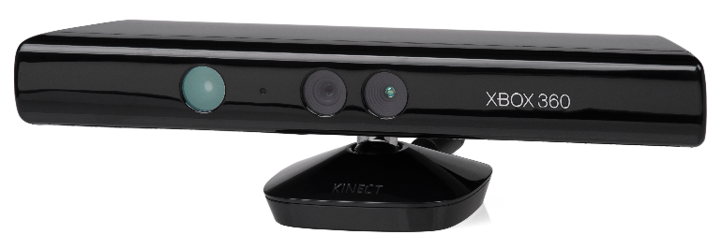
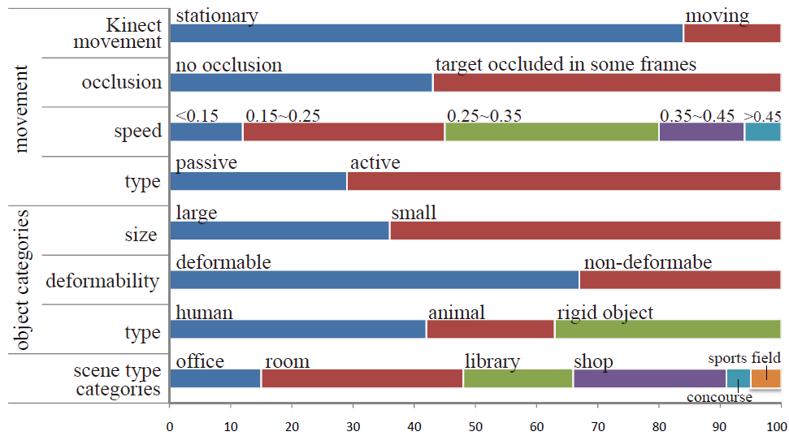
DATASET( )
Princeton Tracking Dataset
5 Validation Video with Ground Truth
95 Evaluation Video

Slide 41
EXPERIMENT
OAPFT (Proposed, with different feature sets)
OI+SVM (SVM tracker with Occlusion Indicator)
ACPF (Adaptive Color Particle Filter)
STRUCK (Structured Output SVM Tracker)
State-of-the-art RGBD tracker
State-of-the-art RGB tracker, Successful for Occlusion Handling
Traditional Particle Filter tracker

Slide 42
CRITERIA I
PASCAL VOC: Overall Performance
1
Success
Area Under Curve
0
t_{o}
Overlap Threshold
1

Slide 43
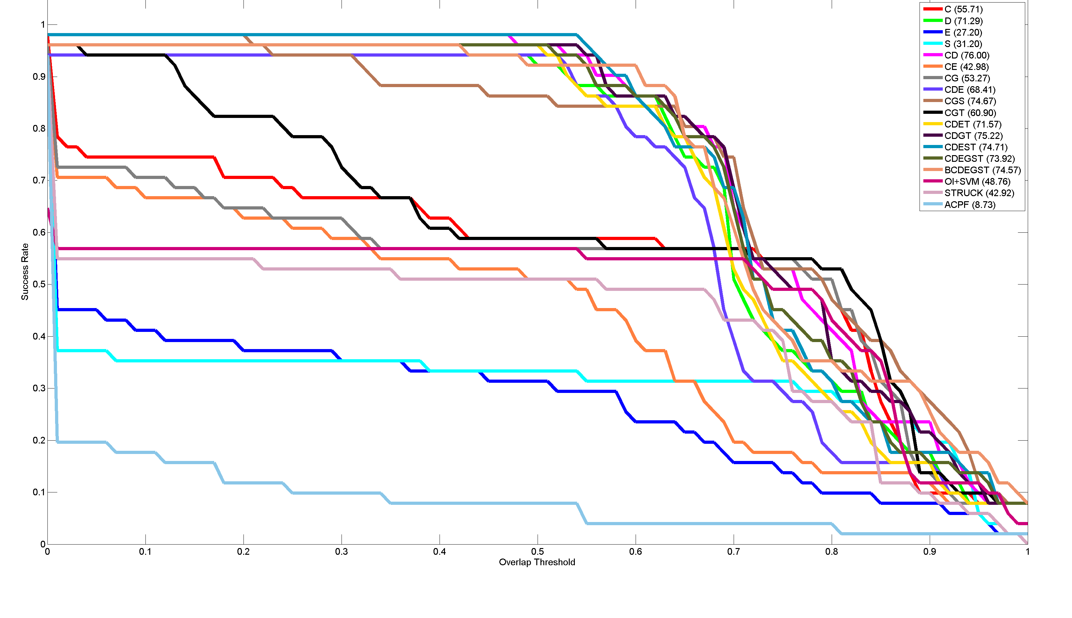
RESULTS
Success Plot
1
1
Success Rate
Overlap Threshold
1
1

Slide 44
CRITERIA II
Mean Central Point Error: Localization Success
Mean Scale Adaption Error
Estimated
Ground Truth

Slide 45
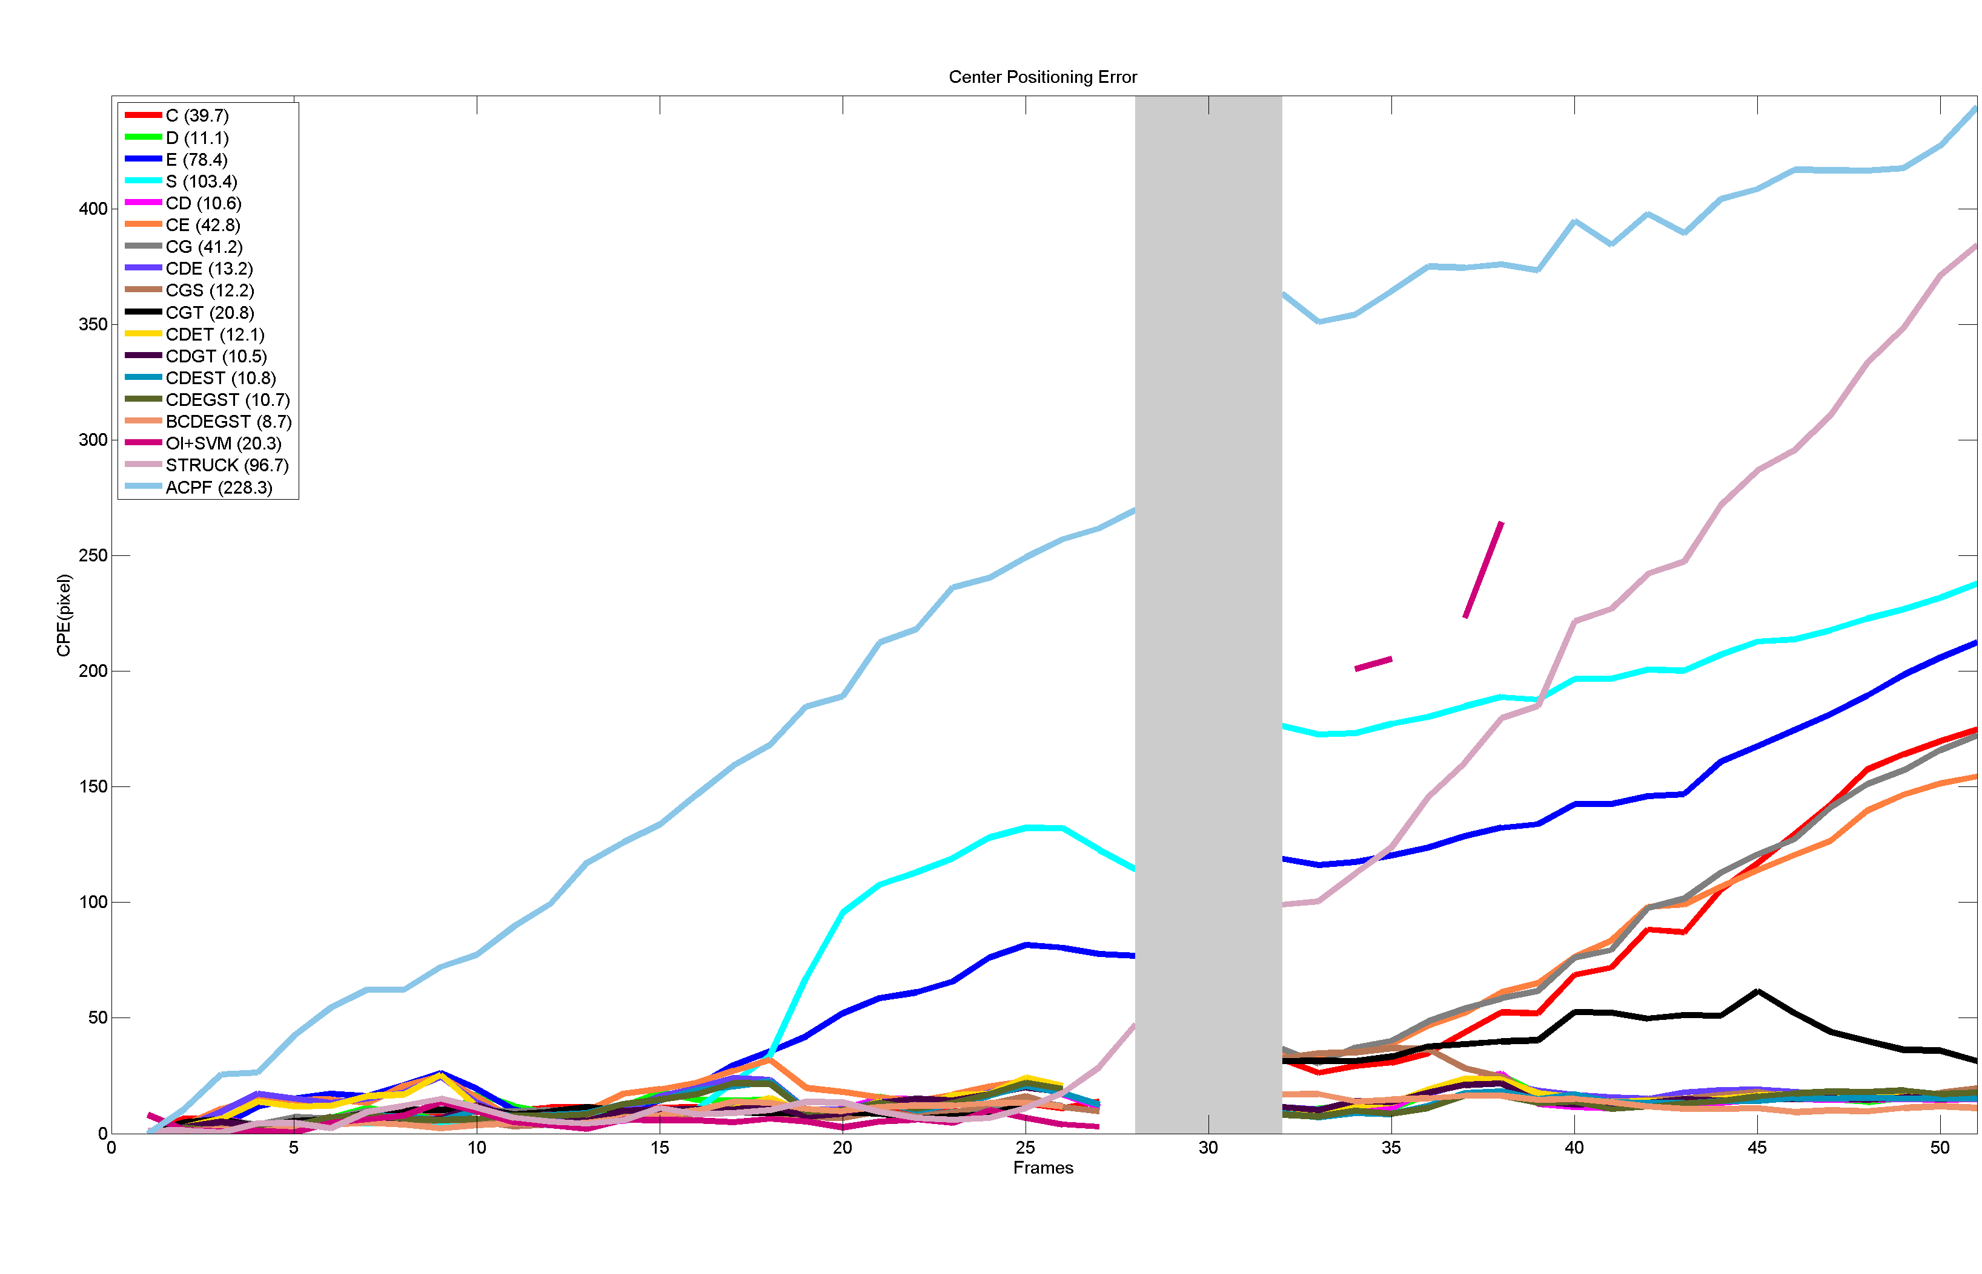
RESULTS
Center Positioning Error
400
CPE (pixels)
Frames
50

Slide 46
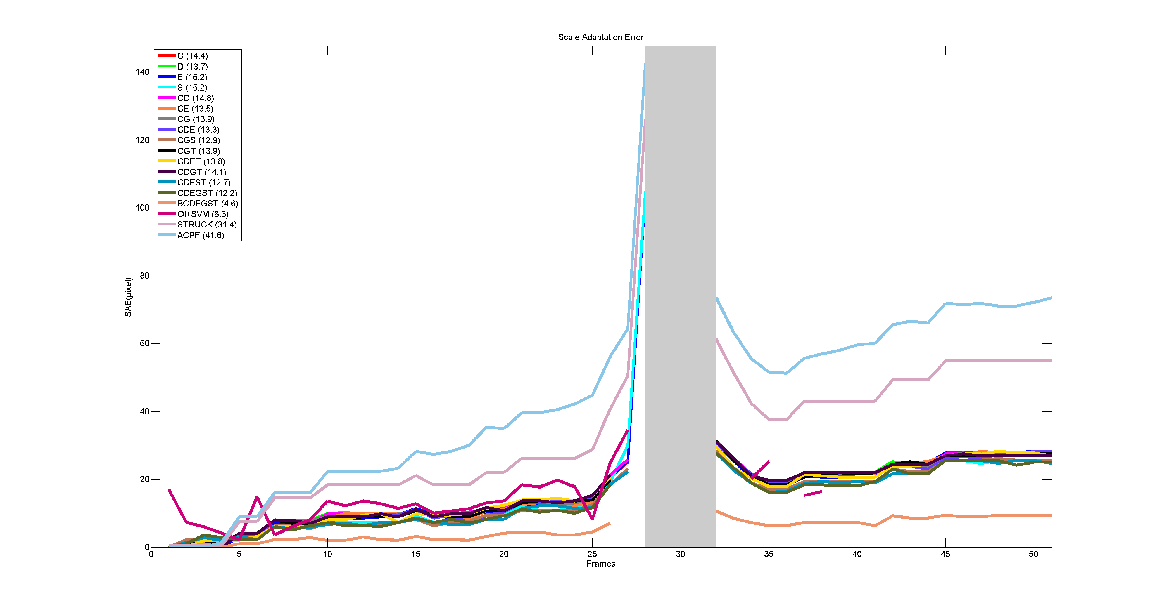
RESULTS
Scale Adaptation Error
140
SAE (pixels)
Frames
50

Slide 47
CRITERIA III
FP happens when a tracker doesn’t realize that the target is occluded.
MI happens when the target is visible but the tracker fails to track it as if the target is still in an occlusion state
MT the estimated bounding box has nothing in common with ground truth box
FPS execution time in frames per second

Slide 48
RESULTS
Tracker | AUC | CPE | SAE | MI | FP | MT | FPS
BCDEGST (proposed) | 76.50 | 9.59 | 7.32 | 0.0 | 2.4 | 0.0 | 0.9
ACPF (Nummiaro ‘03) | 27.55 | 90.38 | 35.27 | 12.6 | 0.0 | 31.0 | 1.4
STRUCK (Hare ‘11) | 46.67 | 68.74 | 26.61 | 12.6 | 0.0 | 64.4 | 13.4
OI+SVM (Song ‘13) | 69.15 | 9.68 | 12.04 | 0.4 | 20.0 | 0.8 | 0.4

Slide 49
FUTURE WORKS
More Resilient Features + Scale Adaptation
Active Occlusion Handling
Measure the Confidence of each Data Channel
Adaptive Model Update

Slide 50
Questions?
Thank you for your time…

